Slide 1

AASD 4000
Machine Learning - I
Applied AI Solutions Developer Program

Slide 2
Module 8
ML Algorithms - I
Vejey Gandyer

Slide 3
Agenda
Model Building Template
Linear Regression
Support Vector Machine
Decision Tree
Random Forest
K-Means

Slide 4
ML Algorithm
What is it?

Slide 5
What is ML Algorithm ?
ML Algorithm is a series of steps that is used to learn a mapping function that converts raw data into set of rules.
Top ML Algorithms you should be familiar with
Linear Regression
Logistic Regression
Naïve Bayes
Gaussian Mixture Models
Support Vector Machine
Decision Tree
Random Forest
Principal Component Analysis
K-Means
XGBoost
LightGBM

Slide 6
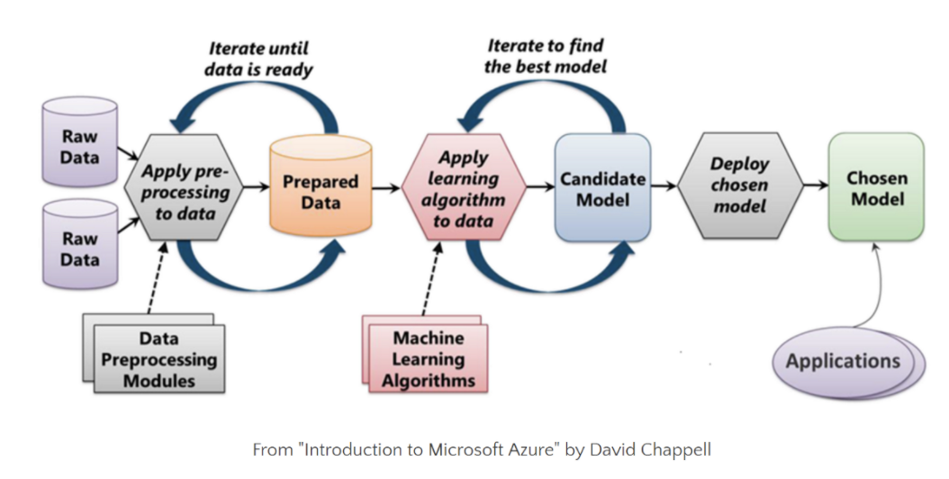
Machine Learning Process

Slide 7
Model Building Template
Choose hyperparameters
Train model
Choose an algorithm
Use / Apply model
Prepare the data

Slide 8
Linear Regression

Slide 9
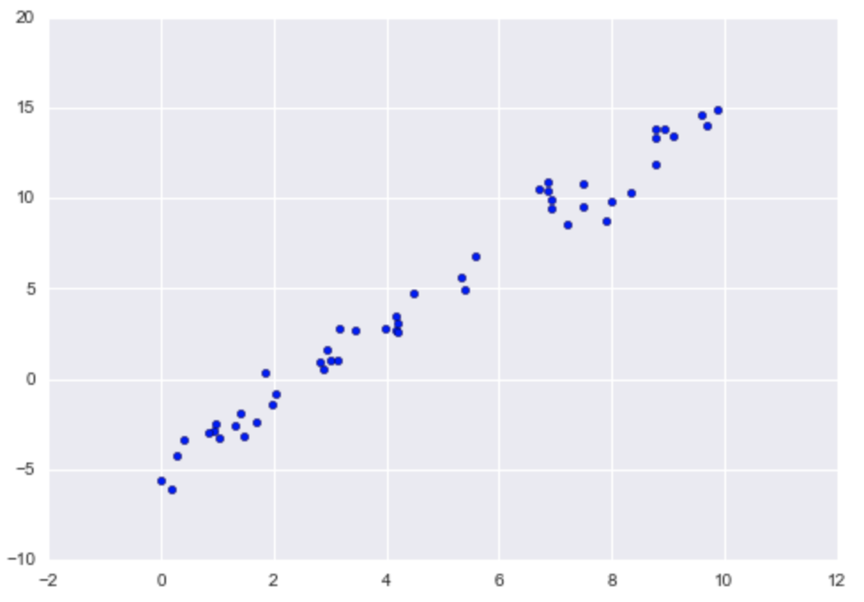

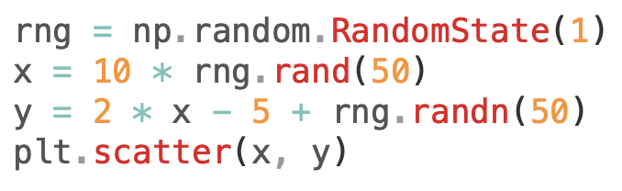
Linear Regression
Linear Regression: Straight-line fit to data
Slope: 2
Intercept: -5

Slide 10
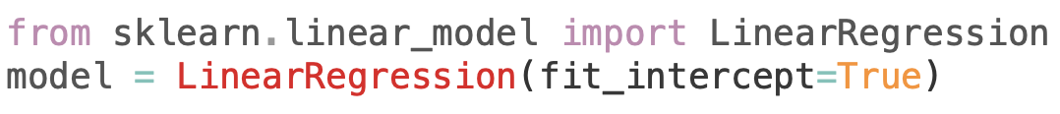
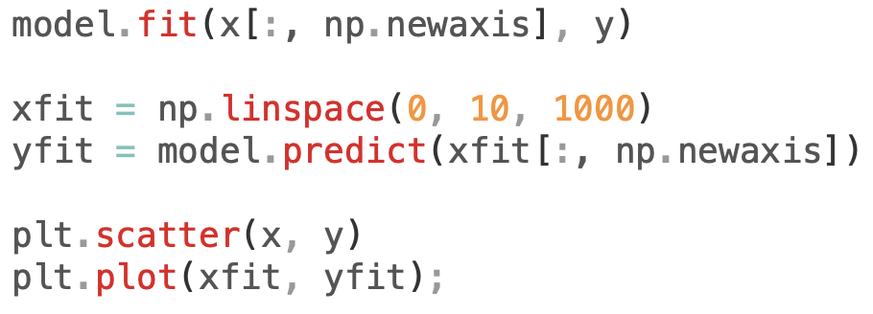
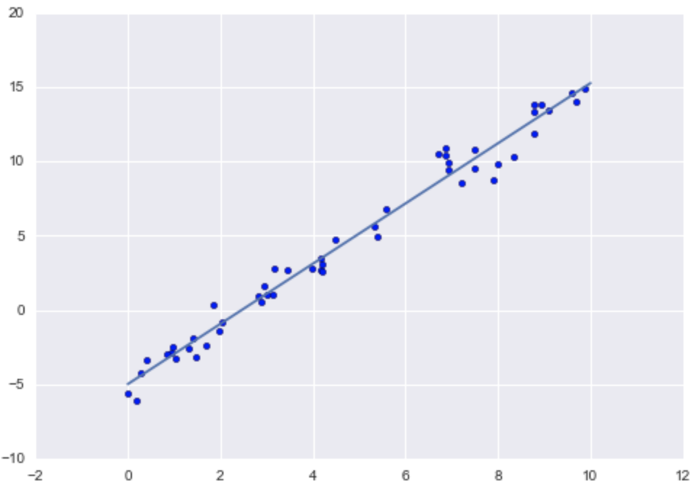
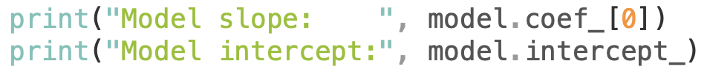

Linear Regression

Slide 11
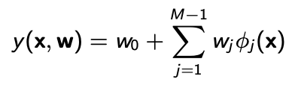

Linear Basis Functions

Slide 12
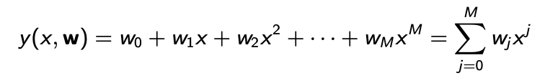
Polynomial Basis Functions

Slide 13
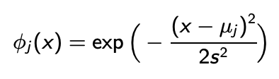
Gaussian Basis Functions

Slide 14

Sigmoidal Basis Functions

Slide 15
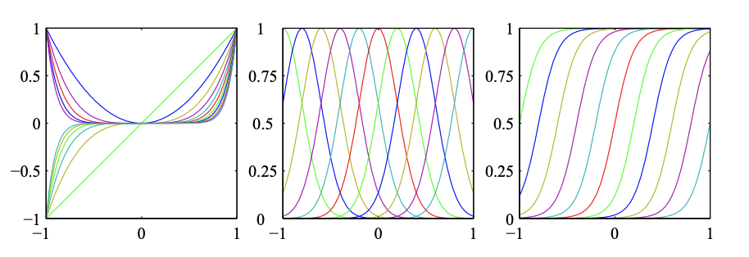
Basis Functions

Slide 16
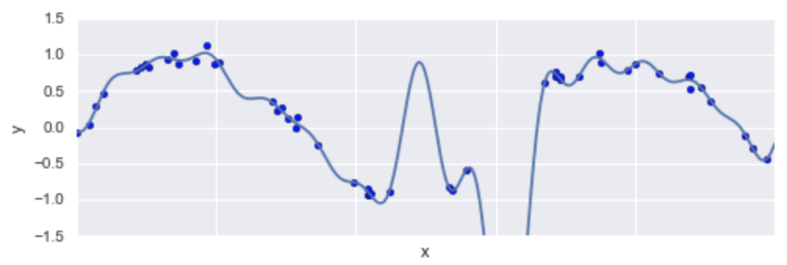
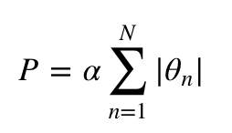
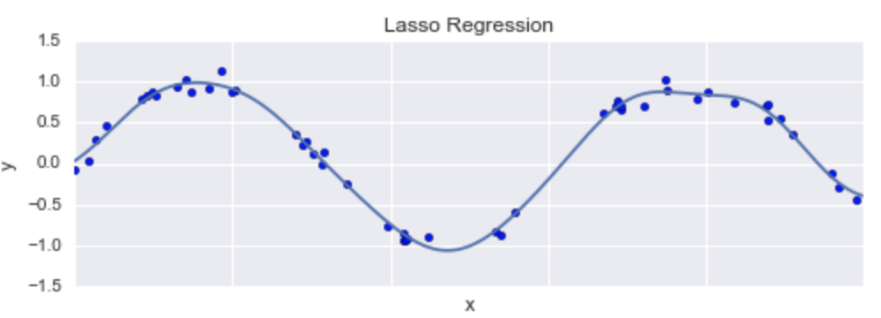
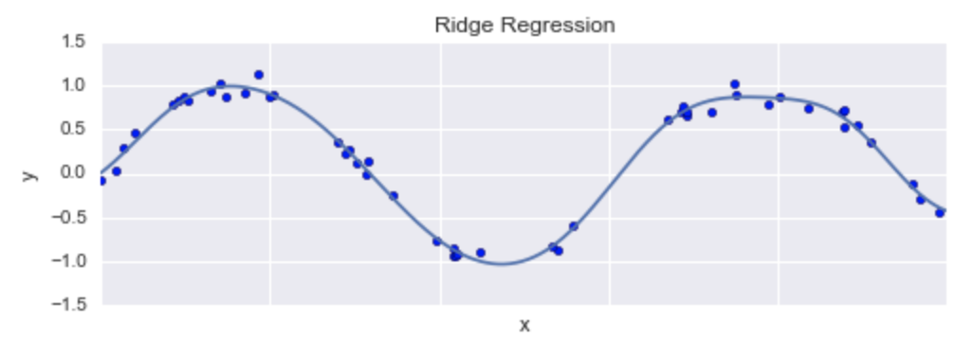
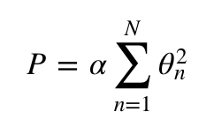
Regularization
Lasso Regression (L₁ Regularization)
Ridge Regression (L₂ Regularization)

Slide 17
Bike Traffic Prediction
Dataset: curl -o FremontBridge.csv https://data.seattle.gov/api/views/65db-xm6k/rows.csv?accessType=DOWNLOAD
Weather data: http://www.ncdc.noaa.gov/cdo-web/search?datasetid=GHCND
Cleaned data: https://github.com/subashgandyer/datasets/blob/main/seattle_bike_data.csv
Steps:
Download the dataset
Explore the dataset
Prepare the dataset
Build the model
Predict on testing data
Report insights
Notebook: ML01_Linear_Regression_Seattle_Bike.ipynb

Slide 18
Support Vector Machine

Slide 19
Support Vector Machine (SVM)
SVMs are powerful and flexible class of supervised algorithms
Classification
Regression
Discriminative classifier: Rather than modeling each class, simply find a line or curve or manifold that divides the classes from each other

Slide 20
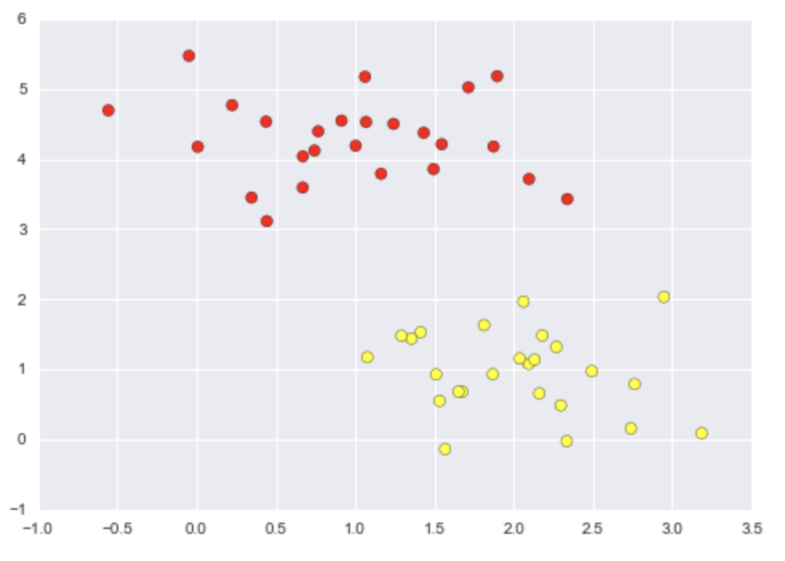
Support Vector Machine (SVM)
SVMs are powerful and flexible class of supervised algorithms
Lets draw a decision boundary

Slide 21
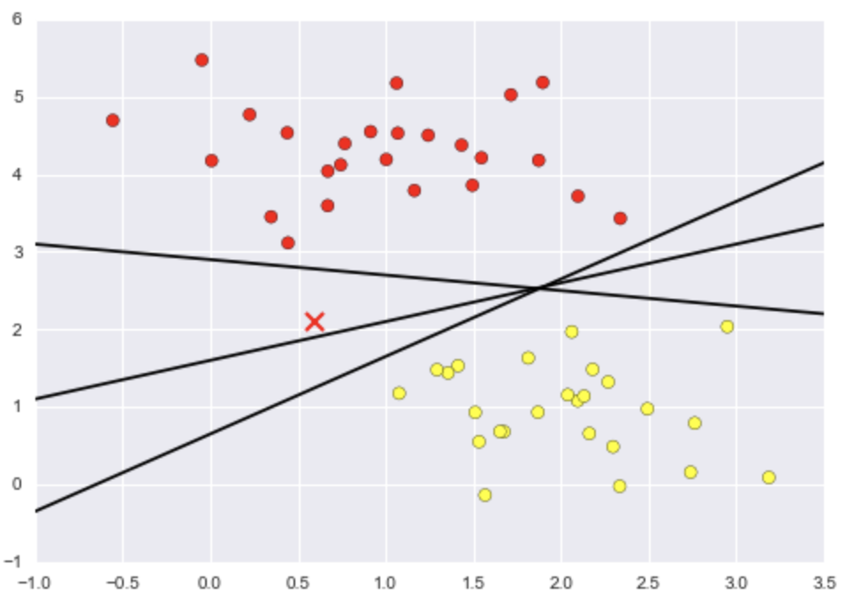
Support Vector Machine (SVM)
Which line to choose?

Slide 22
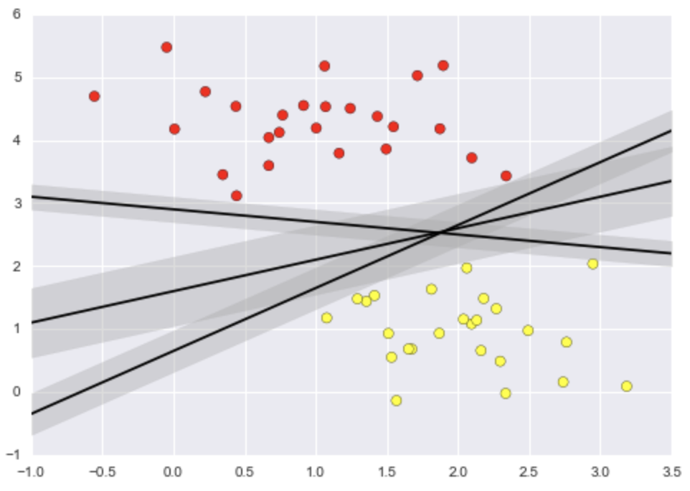
Support Vector Machine (SVM)
Margins

Slide 23
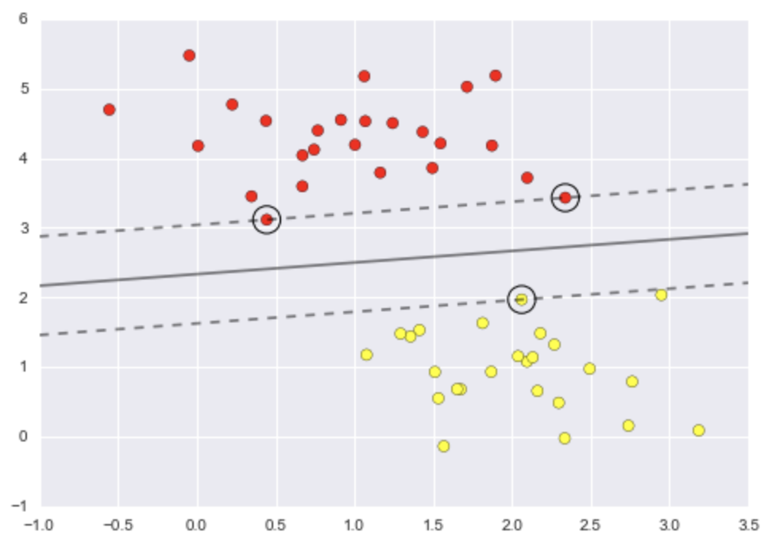
Support Vector Machine (SVM)
Support Vectors

Slide 24
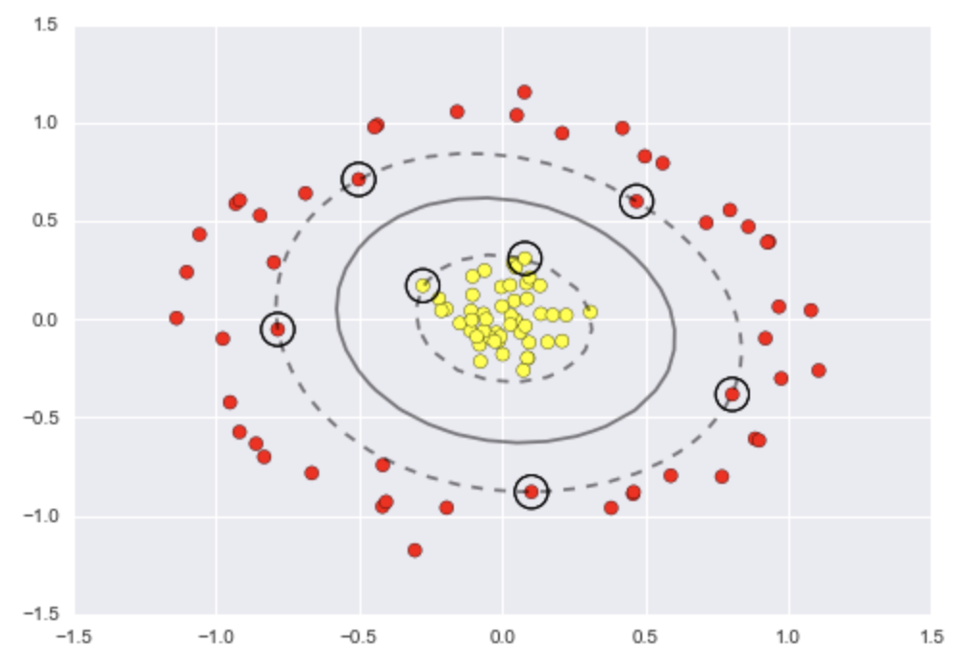
Radial Basis Functions
Non-linear decision boundary
Kernel trick
https://en.wikipedia.org/wiki/Kernel_trick

Slide 25
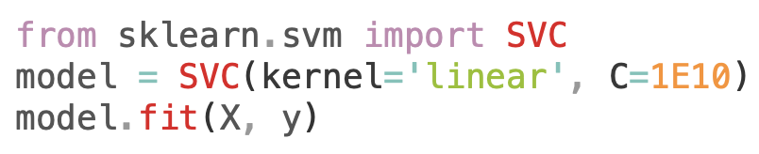

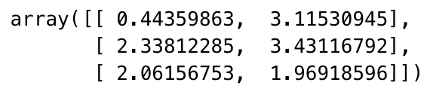
Support Vector Machine (SVM)

Slide 26
Case Study: Face Recognition
Dataset: Sklearn built-in dataset
Notebook: ML02_SVM_Face_Recognition.ipynb

Slide 27
Decision Tree

Slide 28
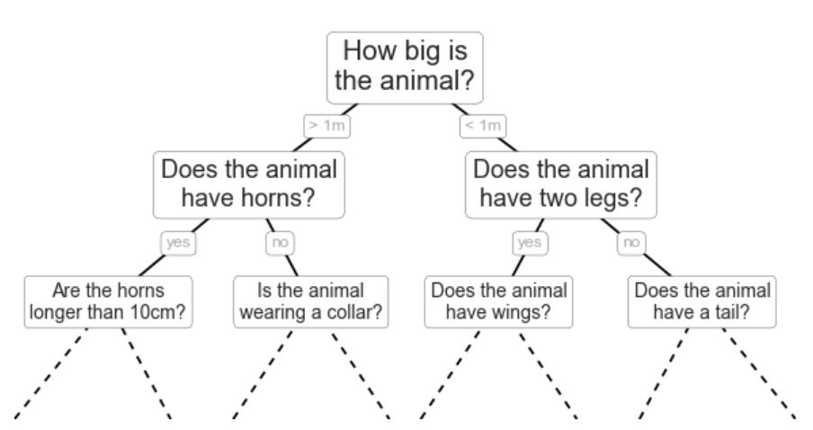
Decision Tree
Non-parametric algorithm
Ask a series of questions designed to zero-in on the classification
Eg: To classify an animal, ask these questions to narrow down the decision process of classifying it
Each question will cut the number of options by half, quickly narrowing down the options.
Which questions to ask at each step???

Slide 29
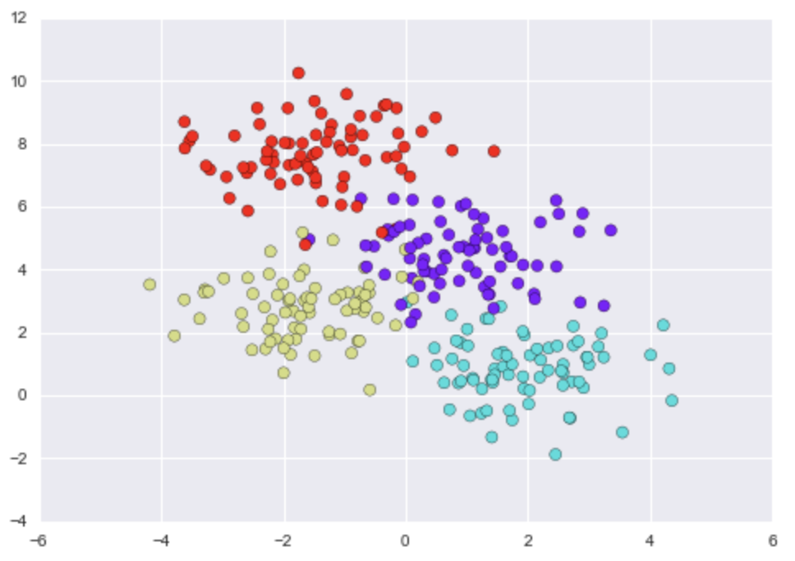
Decision Tree
Use make_blobs()
Iteratively split the data along one or the other axis according to some quantitative criterion
At each level assign the label of the new region according to a majority vote of points within it

Slide 30
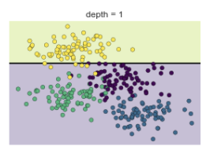
Decision Tree
After first split, every point int the upper branch remains unchanged, so there is no need to further subdivide this branch
Only split further if all nodes are not of one colour (class)

Slide 31
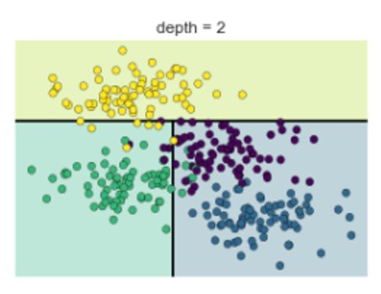
Decision Tree
After second split, every point in the lower left branch remains unchanged, so there is no need to further subdivide this branch even though it has one or two outliers from other classes
Over-fitting happens when there is too much sub-divisions

Slide 32
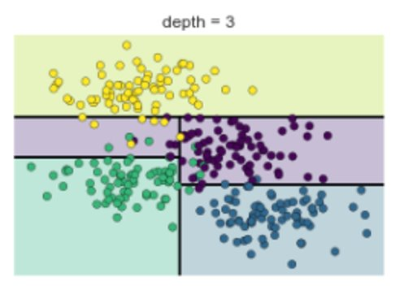
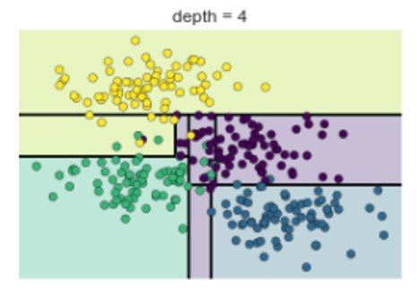
Decision Tree Splitting

Slide 33
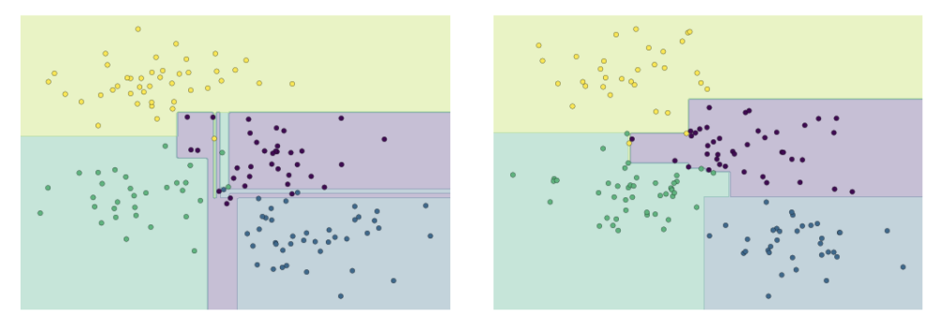
Decision Tree – Over-fitting
Combining two trees' results would help !!

Slide 34
Case Study:
Dataset:
Notebook: ML03_Decision_Tree_Example.ipynb

Slide 35
Random Forests

Slide 36
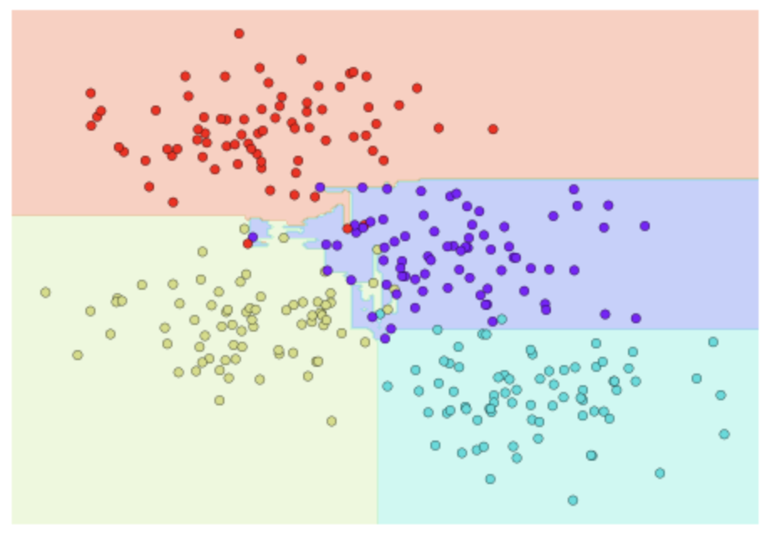
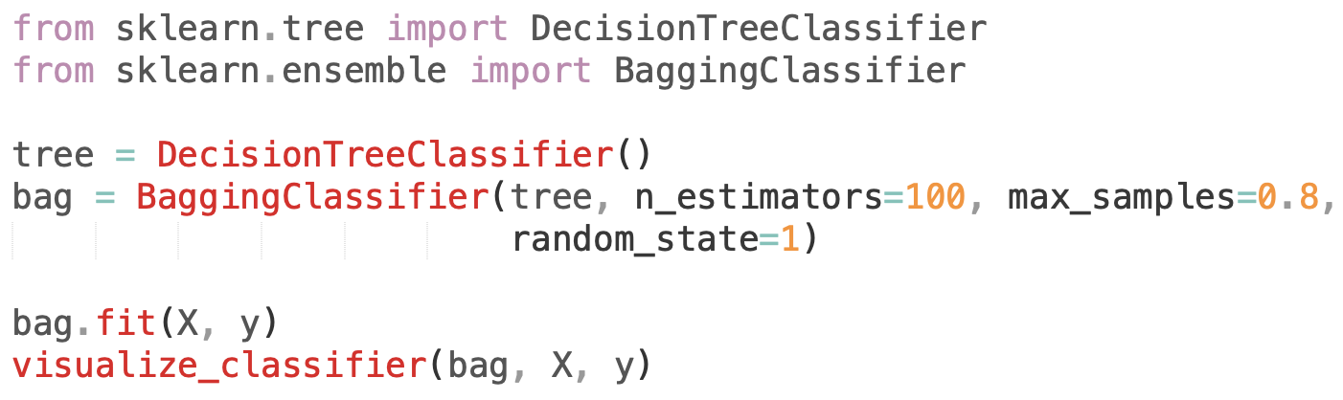
Random Forests
Ensemble - Bagging Algorithm
Multiple overfitting decision tree estimators can be combined to reduce the effect of overfitting
Ensemble of randomized decision trees

Slide 37
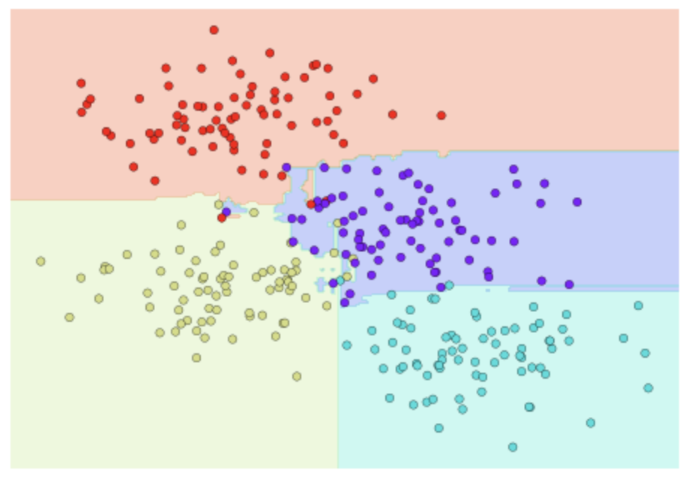
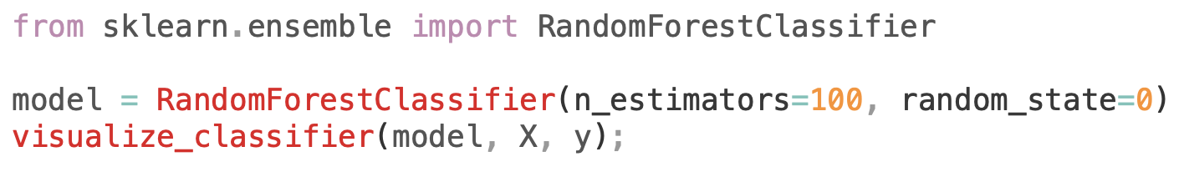
Random Forests
RandomForestClassifier

Slide 38
Random Forests
Fast Training
Fast Inference
Parallel computation can happen for decision trees
Explainability of the models is not that straight

Slide 39
Case Study: Best Random Forest
Dataset:
Notebook:
ML04_Random_Forests_Theory.ipynb
Assignment:
Task8_Best_Random_Forest.ipynb

Slide 40
K-Means

Slide 41
K-Means
Unsupervised algorithm
Searches for a pre-determined number of clusters within an unlabeled multidimensional dataset
Two main assumptions
- Cluster center is arithmetic mean of all points belonging to the cluster
- Each point is closer to its own cluster center than other cluster centers

Slide 42
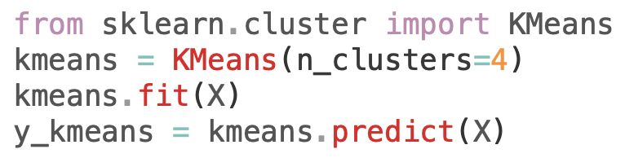
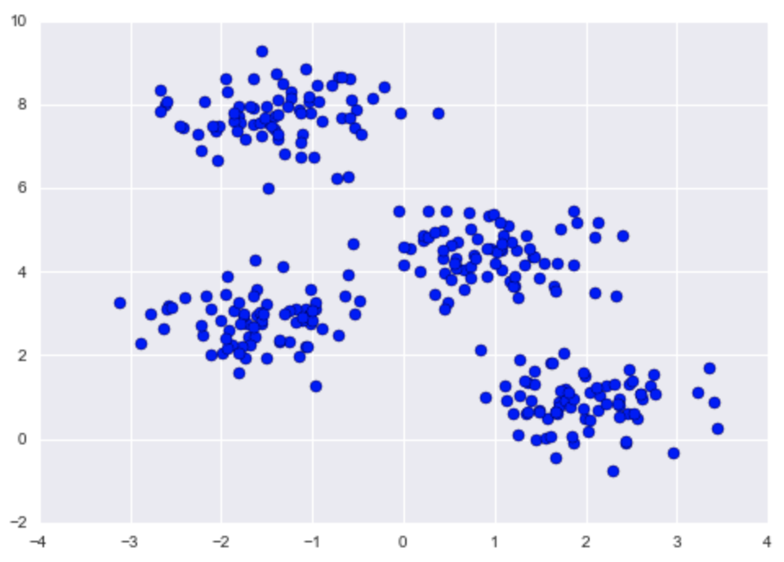
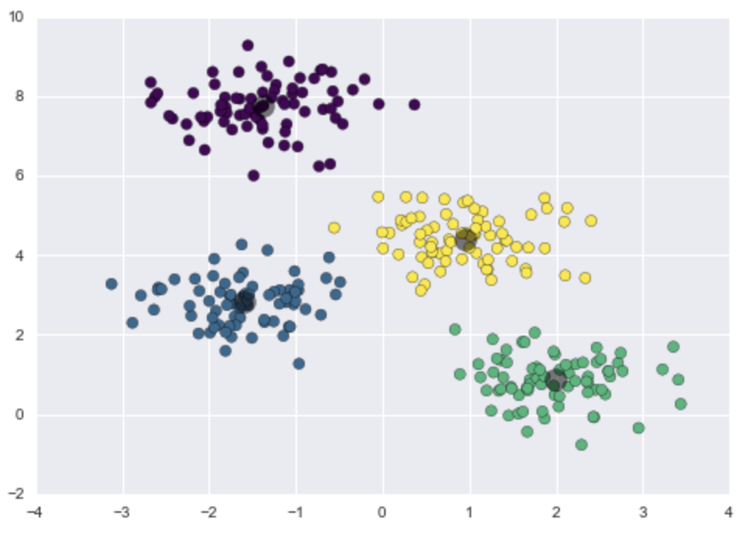
K-Means

Slide 43
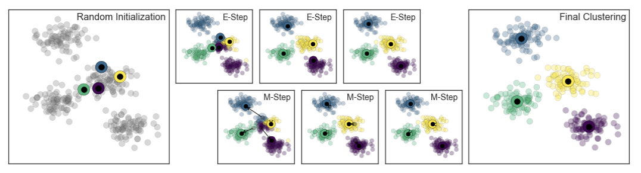
K-Means: Expectation-Maximization (EM)
Guess some cluster centers
Repeat until converged
E-Step: assign points to the nearest cluster center
M-Step: set the cluster centers to the mean

Slide 44
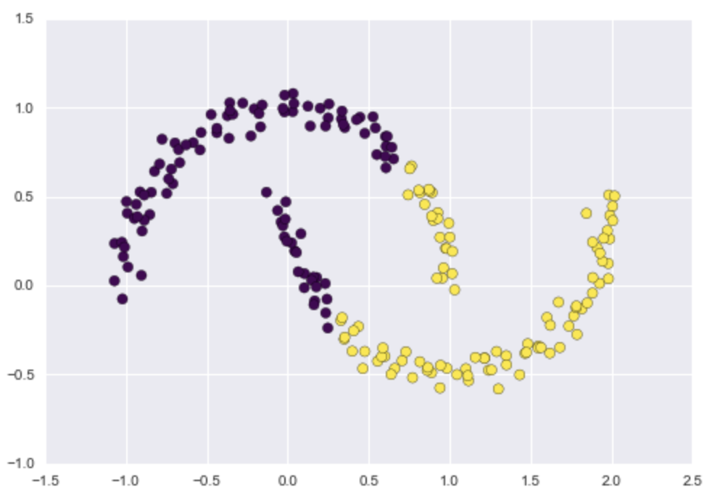
Weaknesses of K-Means
Globally optimal result may not be achieved with different random seeds
Solution: Many runs
Number of clusters should be selected beforehand
Solution: Silhouette Analysis
Limited to only linear cluster boundaries
Solution: SpectralClustering, GMM
Pretty slow for large number of samples
Solution: MiniBatchKMeans

Slide 45
Case Study: Handwritten Digits
Dataset:
Notebook: ML05_KMeans_Example.ipynb

Slide 46
Further Reading
Scikit-learn documentation
https://scikit-learn.org/
Slides and other references made from
Python Data Science Handbook by Jake Vanderplas

